Slide 1
Your mission, should you choose to accept it is…
Agent Tic-Tac-Toe
An interactive game
for computational thinking
Created by Lorenn Ruster

Slide 2
Table of Contents
Section 1: Overview for teachers of “Agent Tic-Tac-Toe” interactive game | Slides 3-12
Section 2: Classroom Handouts for “Agent Tic-Tac-Toe” (teacher notes are included in notes section of the slides) | Slides 13-32

Slide 3
Section 1: Overview for Teachers of Agent Tic-Tac-Toe interactive game
Slide 3

Slide 4
Overview of interactive game “Agent Tic-Tac-Toe”
Audience for the game: Upper High School Students.
Format of lesson: an interactive game played in the classroom
Overview of game:
You are a spy (Agent Jamie Bond). Your mission is to play the next move in a game of tic-tac-toe following a set of instructions contained in a series of envelopes. You will record your findings as you go, in your Agent Report. At the end of the game, you will have made the next move.
For increased difficulty, the game can be played in interaction with another team. In this case, the game can be repeated until a winning move is made.
Time to complete the exercise: 1 hour in order to play one move on the Board including time to explain the task upfront.
Overview of interactive game “Agent Tic-Tac-Toe:
Goal | The student’s task is to follow instructions in order to work out what move needs to be played next on the tic-tac-toe Board.
Role | The student is Agent Jamie Bond, a spy.
Audience | The target audience for the Agent’s Report is the Agent’s Boss, “M.”
Scenario | The student finds themselves in a context where a game of tic-tac-toe has begun and they need to inform “M.” of what move needs to be made next on the tic-tac-toe board.
Product | The product is an Agent’s Report which documents the steps taken to find out what move to make next.
Standards | The standards by which the product will be judged is correct interpretation of the instructions and subsequent correct move on the Board.
Taken from McTighe, J. & Wiggins, G (2006) Understanding by design: Professional development handbook. Heatherton, Victoria: Hawker Brownlow Education.
Slide 4

Slide 5
Lesson objectives
We are learning to:
Develop Algorithmic Thinking* by:
following the types of instructions that a computer would execute
understanding how the tic tac toe ‘Agent’ is operating to play a move
Develop Computational Thinking* by:
computing strings from real-world circumstances
developing applied problem-solving
*As defined in NSW Government Standards Authority (2019). Digital Technologies and ICT Resources. Accessed 28 April 2020, https://educationstandards.nsw.edu.au/wps/portal/nesa/k-10/learning-areas/technologies/coding-across-the-curriculum
Slide 5

Slide 6
What I’m looking for in students’ work:
Problem solving
Asking questions when unsure
Development of computational thinking skills:
Decomposition
Pattern recognition
Algorithmic thinking
Following instructions
Teamwork (if played in teams)
Slide 6

Slide 7
Possible variations on the format of the game:
The teacher using these materials could also consider the game taking place in teams instead of individually.
The envelopes could be strategically placed in different locations with ‘clues’ regarding their location added based on the physical environment (to make it more “Amazing Race” style).
It may make sense for there to be a checkpoint with a teacher after the “Your Secret Weapons” envelope to ensure that students don’t get lost from the beginning (to be decided by the teacher)
To increase the difficulty:
Code associated with each step could be added to the instructions or to the Agent Report.
Options of code could be added and students required to select which code corresponds to the moves just made.
Students could change the algorithm and adjust the steps in the game to match.
Several loops of the sequence can be connected together by adding an envelope that exposes the next move of the opponent. Teams can also be paired together to play moves against eachother.
Slide 7

Slide 8
The game follows these steps (different steps are reflected in different envelopes)
Documentation of explicit algorithm:
Find out if we are “X” or “0” by checking the number of X’s and 0’x. If they are equal then we are X, if not then we are 0
If there is a possibility to ‘win’ i.e. to have three of our pieces in a row, play that move. This means checking if there are 2 out of 3 of our pieces present in the following sequences and then playing the remaining position:
(0, 1, 2), # top row Here's the board:
(3, 4, 5), # middle row 0 1 2
(6, 7, 8), # bottom row 3 4 5
(0, 3, 6), # left column 6 7 8
(1, 4, 7), # middle column
(2, 5, 8), # right column
(0, 4, 8), # top-left to bottom-right diagonal
(2, 4, 6), # top-right to bottom-left diagonal
If there a possibility to block the opponent from winning i.e. to block the opponent from playing three of their pieces in a row, play that move. This means checking if there are 2 out of 3 of our opponent’s pieces present in the following sequences and then playing the remaining position:
(0, 1, 2), # top row Here's the board:
(3, 4, 5), # middle row 0 1 2
(6, 7, 8), # bottom row 3 4 5
(0, 3, 6), # left column 6 7 8
(1, 4, 7), # middle column
(2, 5, 8), # right column
(0, 4, 8), # top-left to bottom-right diagonal
(2, 4, 6), # top-right to bottom-left diagonal
If the middle square (position 4 according to the numbering of the grid) is available, take it
If top left corner (position 0) is available, take it
If top right corner (position 2) is available, take it
If bottom left corner (position 6) is available, take it
If bottom right corner (position 8) is available, take it
Otherwise, take first available position
Envelope #2
Envelope #3 & #4
Envelope #5 & #6
Envelope #7 & #8
Slide 8

Slide 9
How the game is played
There is the possibility of continuing the play further moves in the game through a loop
Envelope #4
Envelope #6
Yes
Yes
Your Secret Weapons – TOP SECRET envelope
Introduction envelope
Envelope #1
Envelope #2
Envelope #3
Any yes response?
Any yes response?
Envelope #8 (END)
No
Envelope #5
No
Envelope #7
Students start with a particular tic-tac-toe board and need to follow the instructions regarding what move they will make next
Students end the game having played the next move, following the instructions
Slide 9

Slide 10
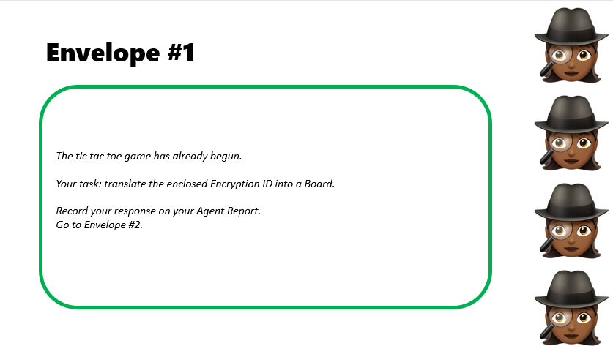
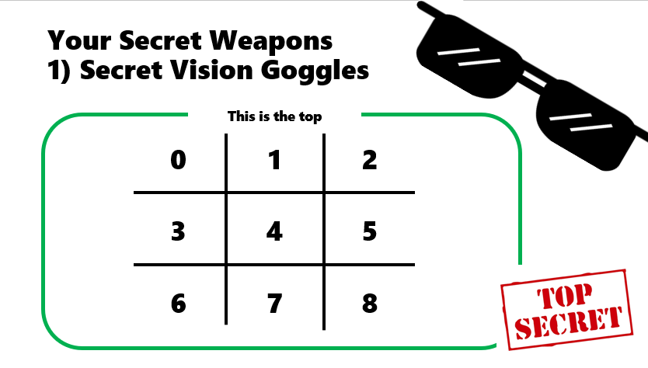
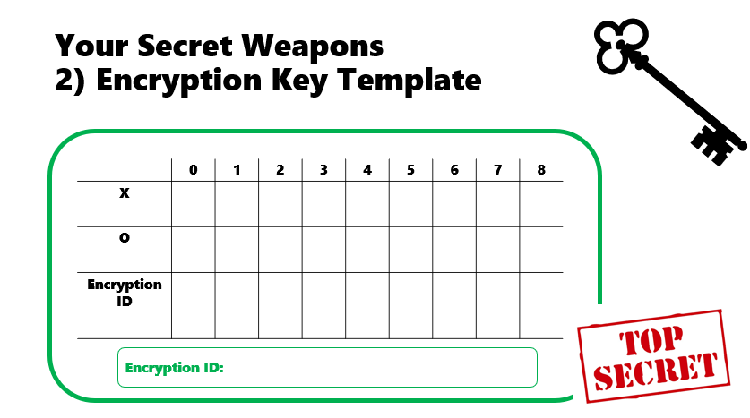
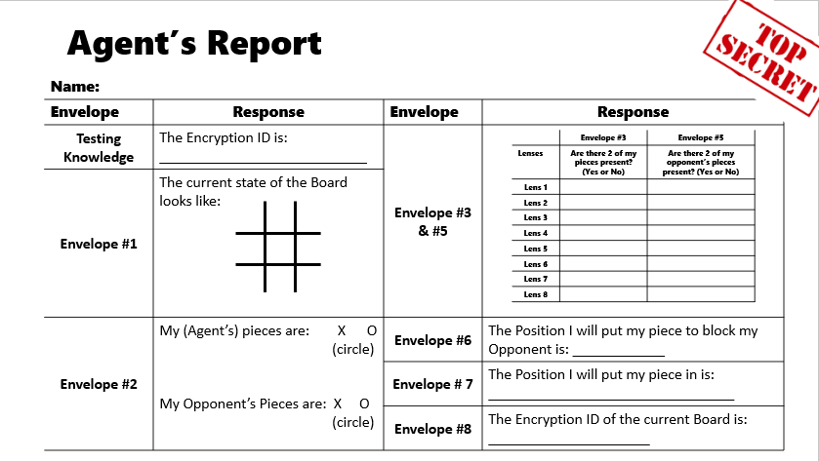
Overview of Classroom materials
Your Secret Weapons – TOP SECRET envelope
Envelope #1
Introduction envelope
Envelope #2
x3 copies
Slide 10

Slide 11
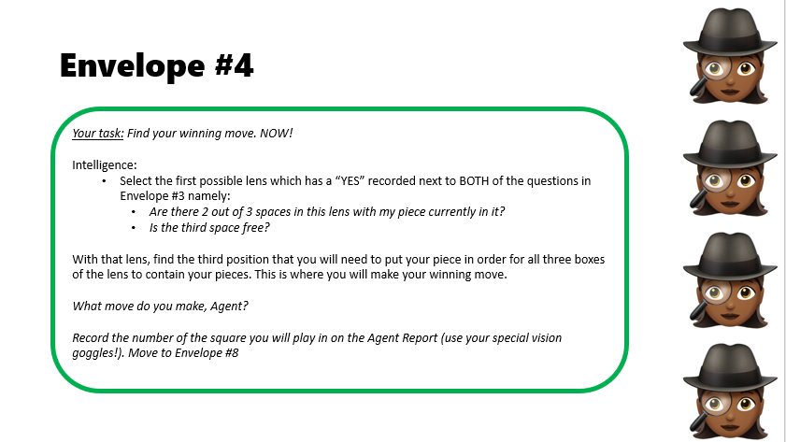
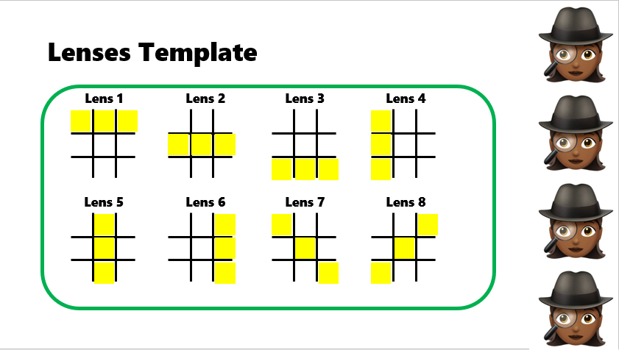
Overview of classroom materials
Envelope #3
Envelope #4
Envelope #5
Slide 11

Slide 12
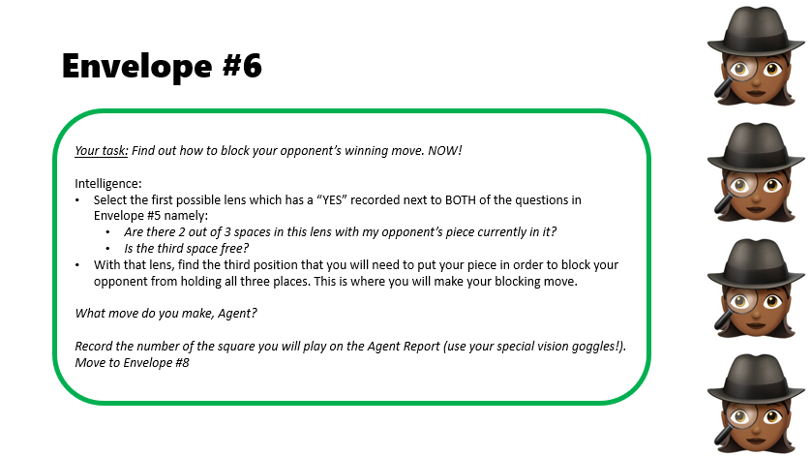
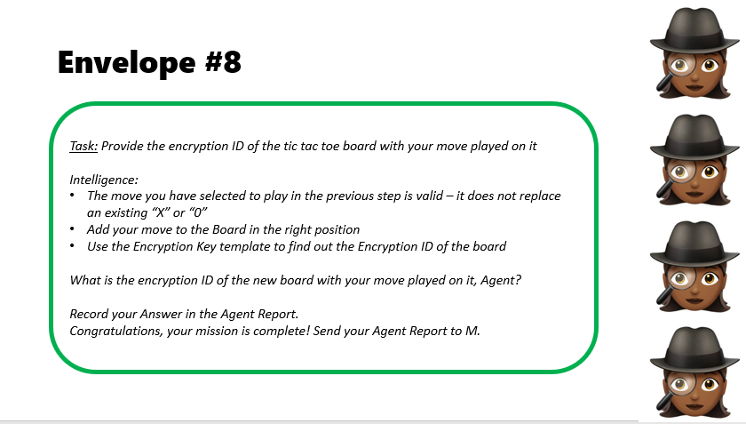
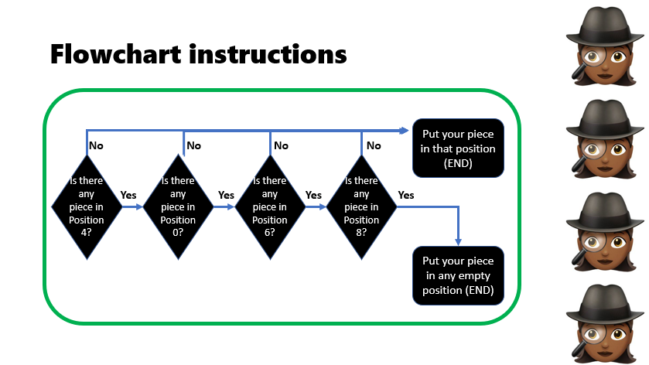
Overview of classroom materials
Envelope #6
Envelope #7
Envelope #8
Slide 12

Slide 13
Section 2: Classroom materials (for printing)
(Teacher notes are in the notes section of these slides)
Slide 9

Slide 14
Introduction Envelope – START HERE!
You are Jamie Bond, an undercover agent.
Your mission, Agent, should you choose to accept it, is to follow the instructions of your boss, M. You’ll be playing a game of tic tac toe (also known as naughts and crosses).
Remember, you must follow the instructions at all times and at all costs.
No deviations are allowed.
You’ve chosen to accept this mission.
Go to the envelope labelled “Your secret weapons – TOP SECRET”
Notes:
Teacher notes: Print Introduction Envelope instructions and place inside envelope labelled “Introduction Envelope – START HERE”

Slide 15
Your Secret Weapons – TOP SECRET
All of our agents have two very special secret weapons.
Special secret weapon #1: Secret Vision Goggles (see enclosed).
These help you see the tic tac toe board in a whole new way
– using numbers. Make sure you use them the right way up!!
Special secret weapon #2: The Encryption Key Template (see enclosed).
This helps you create what is known as an
encryption ID.
All Agents must document their progress in the Agents Report (enclosed).
Notes:
Teacher notes: Print “Your Secret Weapons – TOP SECRET envelope” instructions, place inside labelled envelope and also include the following materials in this envelope:
Secret Weapons Test – TOP SECRET – 1 per individual/team
Secret Vision Goggles – 1 per individual/team
Encryption Key Template – 3 per individual/team
Encryption Key Worked Example – 1 per individual/ team
Testing your knowledge exercise – 1 per individual/team
Agent’s report – 1 per individual/team

Slide 16
Your Secret Weapons 1) Secret Vision Goggles
This is the top
0
1
2
3
4
5
6
7
8
Notes:
Teacher notes: Print one copy per student/ team of the Secret Vision Goggles and place inside the envelope “Your Secret Weapons – TOP SECRET envelope”. If these can be printed on a transparency that would work even better.

Slide 17
Your Secret Weapons 2) Encryption Key Template
 | 0 | 1 | 2 | 3 | 4 | 5 | 6 | 7 | 8
X
O
Encryption ID
Encryption ID:
Notes:
Teacher notes: Print three copies of Encryption Key Template per person/team (and have a few spares on hand) and place inside the envelope “Your Secret Weapons – TOP SECRET envelope”.

Slide 18
Secret Weapons Test – TOP SECRET
Before sending you into the field, “M” (your boss) must check that
you know how to use these secret weapons!
See the document “Encryption Key Worked Example” enclosed for
an example.
To test your knowledge, take a look at “Encryption Key – test
your knowledge” (enclosed).
Record the test Encryption Key ID on your Agent Report.
If correct, move on to Envelope #1.
Notes:
Teacher notes: Print one copy per student/ team of the Secret Weapons test and place inside the envelope “Your Secret Weapons – TOP SECRET envelope”.

Slide 19
Encryption Key Worked Example
Encrypt this Board
 | 0 | 1 | 2 | 3 | 4 | 5 | 6 | 7 | 8
X
O
Encryption ID | O | X | . | . | X | . | X | O | .
O
X
X
X
O
Encryption ID: O X..X.XO.
Notes:
Teacher notes: Print one copy per student/ team of the Encryption Key Worked Example and place inside the envelope “Your Secret Weapons – TOP SECRET envelope”.

Slide 20
Encryption Key – Test your knowledge
Encrypt this Board
Into an encryption ID
X
Encryption ID:
X
O
Use an encryption key template to work it out
Notes:
Teacher notes: Print one copy per student/ team of the Encryption Key – Test your knowledge and place inside the envelope “Your Secret Weapons – TOP SECRET envelope”.

Slide 21
Agent’s Report
Name:
Envelope | Response | Envelope | Response
Testing Knowledge | The Encryption ID is: ___________________________ | Envelope #3 & #5
Envelope #1 | The current state of the Board looks like:
Envelope #2 | My (Agent’s) pieces are: X O (circle) My Opponent’s Pieces are: X O (circle) | Envelope #6 | The Position I will put my piece to block my Opponent is: ____________
 |  | Envelope # 7 | The Position I will put my piece in is: ________________________________
 |  | Envelope #8 | The Encryption ID of the current Board is: _____________________
 | Envelope #3 | Envelope #5
Lenses | Are there 2 of my pieces present? (Yes or No) | Are there 2 of my opponent’s pieces present? (Yes or No)
Lens 1
Lens 2
Lens 3
Lens 4
Lens 5
Lens 6
Lens 7
Lens 8
Notes:
Teacher notes: Print one copy per student/ team of the Agent’s Report and place inside the envelope “Your Secret Weapons – TOP SECRET envelope”.

Slide 22
Envelope #1
The tic tac toe game has already begun.
Your task: translate the enclosed Encryption ID into a Board.
Record your response on your Agent Report.
Go to Envelope #2.
Notes:
Teacher notes: Print instructions for “Envelope #1” and place inside labelled envelope with:
Encryption ID

Slide 23
Encryption IDs
Use these if you want students to do many loops
Other
Use these if you want students to do one loop and win the game
Encryption ID: …XO…
Encryption ID: X.O.O.X.O
Encryption ID: XOX.O…X
Encryption ID: ….O….
Encryption ID: X.O.X…O
Encryption ID: X.XOO.O.X
Encryption ID : ..O.X….
Encryption ID: .XO.X….
EEncryption ID: XXO.O.X.O
Encryption ID: .O….X..
Encryption ID: OX….X..
Encryption ID: .X.OX…O
Notes:
Teacher notes: Cut these encryption IDs out individually. Include one in each Envelope #1.
If the game is being played with pairs of teams, you can use the output from Envelope #8 as the input Encryption ID.

Slide 24
Envelope #2
Your task: Find out whether your piece is an “X” or an “O”
Intelligence received:
There are two types of pieces “X” and “O”
Once a piece is played, it cannot be removed or replaced
X always plays first
You have the next move, Agent
If there are equal numbers of “X” pieces to “O” pieces on the board (Remember you found out the current state of the Board in Envelope #1), then the next move is “X”. If not, then the next move is “O”
What pieces do you play Agent? (“X” or “0”)
Record your response in your Agent Report
Move on to Envelope #3.
Notes:
Teacher notes: Print instructions for “Envelope #2” and place inside labelled envelope

Slide 25
Envelope #3
Your task: Find out if you have a winning move that can be played.
Intelligence received:
Inside the envelope is a series of lenses for your secret vision goggles for you to check if there is a winning move that can be played.
Apply each lens over the current board (the one you generated from Envelope #1).
For each lens, check:
Are there 2 out of 3 spaces in this lens with my piece currently in it?
Is the third space free?
Record your findings in the Agent Report
If your answer to both of these questions is “YES” for at least one lens, go to Envelope #4. If not, go to Envelope #5
Notes:
Teacher notes: Print instructions for “Envelope #3” and place inside labelled envelope with Lenses Template

Slide 26
Lenses Template
Lens 1
Lens 2
Lens 3
Lens 4
Lens 5
Lens 6
Lens 7
Lens 8
Notes:
Teacher notes: Print Lenses Template and place inside labelled Envelope #3.
Note – a stretch task here would be for students to build the lenses from numbers e.g. Lens 1 built from (0,1,2); Lens 8 from (2,4,6)

Slide 27
Envelope #4
Your task: Find your winning move. NOW!
Intelligence:
Select the first possible lens which has a “YES” recorded next to BOTH of the questions in Envelope #3 namely:
Are there 2 out of 3 spaces in this lens with my piece currently in it?
Is the third space free?
With that lens, find the third position that you will need to put your piece in order for all three boxes of the lens to contain your pieces. This is where you will make your winning move.
What move do you make, Agent?
Record the number of the square you will play in on the Agent Report (use your special vision goggles!). Move to Envelope #8
Notes:
Teacher notes: Print instructions for “Envelope #4” and place inside labelled envelope

Slide 28
Envelope #5
Your task: Find out if your opponent has a winning move that can be played.
Intelligence:
Use the same lens template as from Envelope #3 for you to check if there is a winning move that can be played by your opponent.
Apply each lense over the current board (from Envelope #1).
For each lens, check:
Are there 2 out of 3 spaces in this lens with my opponent’s piece currently in it?
Is the third space free?
Record your findings in the Agent Report
If your answer to any of these lenses is “YES” for BOTH questions, go to Envelope #6. If not, go to Envelope #7
Notes:
Teacher notes: Print instructions for “Envelope #5” and place inside labelled envelope

Slide 29
Envelope #6
Your task: Find out how to block your opponent’s winning move. NOW!
Intelligence:
Select the first possible lens which has a “YES” recorded next to BOTH of the questions in Envelope #5 namely:
Are there 2 out of 3 spaces in this lens with my opponent’s piece currently in it?
Is the third space free?
With that lens, find the third position that you will need to put your piece in order to block your opponent from holding all three places. This is where you will make your blocking move.
What move do you make, Agent?
Record the number of the square you will play on the Agent Report (use your special vision goggles!). Move to Envelope #8
Notes:
Teacher notes: Print instructions for “Envelope #6” and place inside labelled envelope

Slide 30
Envelope #7
Task: Find your next move using the document titled “Flowchart instructions”
Intelligence:
Follow the instructions enclosed called “Flowchart instructions”
What position do you put your piece in, Agent?
Record it on the Agent Report
Move to Envelope #8
Notes:
Teacher notes: Print instructions for “Envelope #7” and place inside labelled envelope with “Flowchart instructions”

Slide 31
Flowchart instructions
Put your piece in that position (END)
No
No
No
No
Is there any piece in Position 4?
Is there any piece in Position 0?
Is there any piece in Position 6?
Is there any piece in Position 8?
Yes
Yes
Yes
Yes
Put your piece in any empty position (END)
Notes:
Teacher notes: Print instructions for “Flowchart instructions: and place inside labelled envelope with “Envelope #7”

Slide 32
Envelope #8
Task: Provide the encryption ID of the tic tac toe board with your move played on it
Intelligence:
The move you have selected to play in the previous step is valid – it does not replace an existing “X” or “0”
Add your move to the Board in the right position
Use the Encryption Key template to find out the Encryption ID of the board
What is the encryption ID of the new board with your move played on it, Agent?
Record your Answer in the Agent Report. Congratulations, your mission is complete! Send your Agent Report to M.
Notes:
Teacher notes: Print instructions for “Envelope #8” and place inside labelled envelope
Note the encryption ID of the new board could then form the encryption ID input for another team in envelope #1 (if you wanted the game to continue to play from here).

